Slide 1
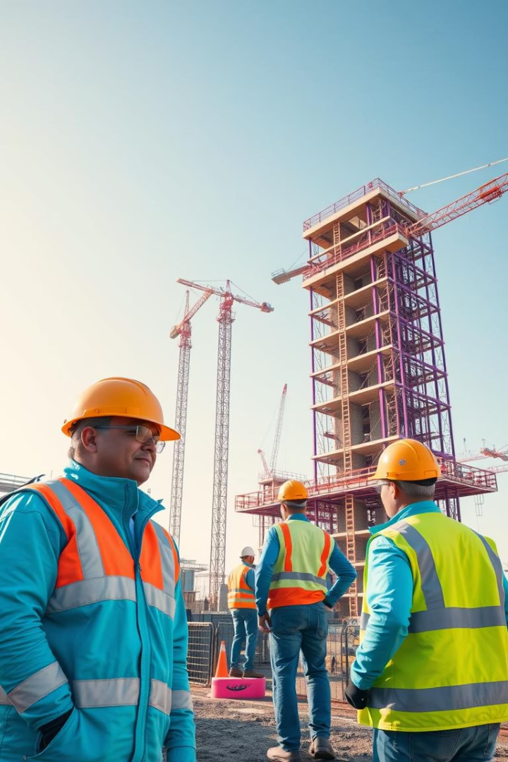
Construction Site Safety Rules
Safety depends on everyone: governments, managers, supervisors, workers. Precise measures reduce accidents and ill health. Main hazards: falls, vehicles, electrocutions, machinery, falling objects.

Slide 2

Personal Protective Equipment (PPE)
Essential PPE
Hard hats
Goggles and gloves
Earplugs
Safety boots
High visibility clothing
Purpose
Reduce exposure to hazards and injuries

Slide 3
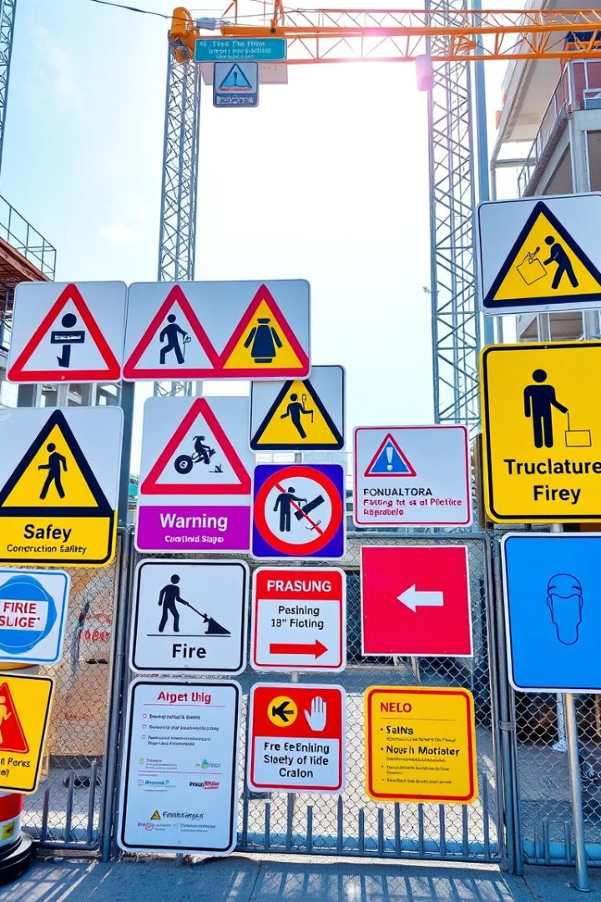

Safety Signs & Awareness
Types of Signs
Placement
Prohibition, mandatory, warning, safe condition, fire-fighting
Clear, visible, and strategically positioned
Worker Awareness
Familiarity with signs is crucial

Slide 4

Site Inductions & Instructions
Site Induction
Intro to site operations for newcomers
Toolbox Talks
Daily or frequent safety reminders
Clear Instructions
Prevent misunderstandings and accidents

Slide 5
Keep Site Clean and Organized
Daily Cleaning
Tool Storage
Benefits
Remove debris, dust, and stagnant water
Organize tools, unplug power equipment when not in use
Prevent slips, trips, injuries, and tool damage

Slide 6

Use Proper Tools & Equipment
Right Tool for Job
Improves Efficiency
Avoid makeshift or improper tool use
Completes tasks faster and safer
Reduces Accidents
Prevents misuse-related injuries

Slide 7
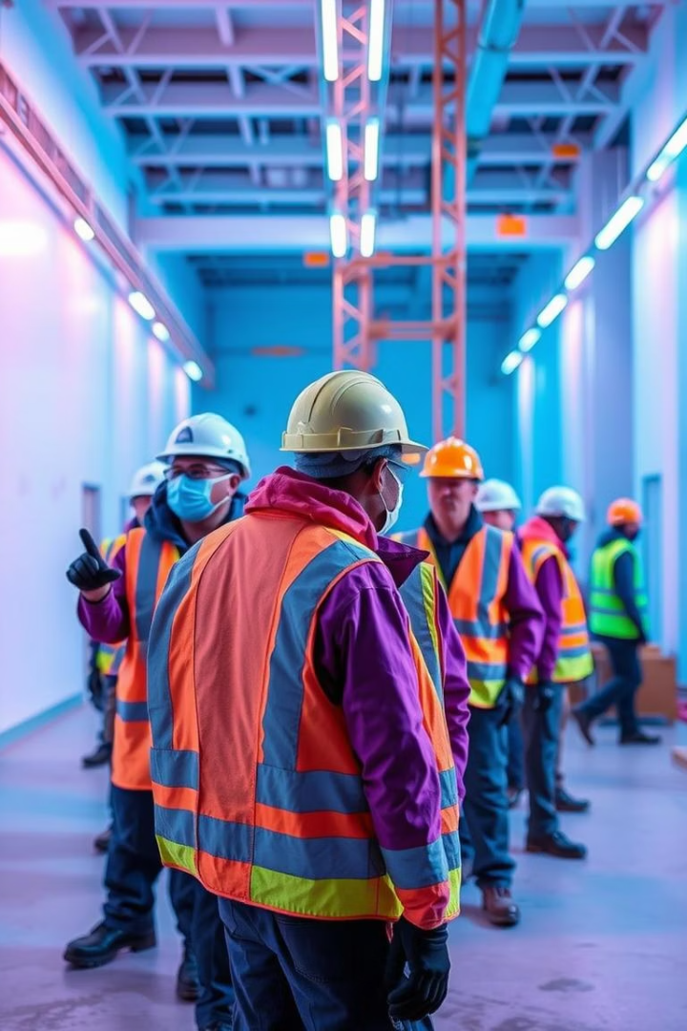



Emergency Response Plans
Planning
Detail response actions for emergencies
Responsible Team
Manage crises and report hazards
Training
Regular drills for preparedness

Slide 8



Safety Barriers & Controls
2
Electrical Safeguards
Isolate high-voltage equipment
Barriers & Fences
1
Keep workers away from hazards
Toxic Chemicals
3
Prevent exposure to fumes

Slide 9
Pre-Checks & Reporting
Pre-Use Checks
Immediate Reporting
Early Action
Inspect tools and equipment for damage
Report unsafe conditions promptly
Minimizes risk of escalation and accidents

Slide 10

Summary & Key Takeaways
Wear PPE Always
Follow Safety Signs
Prevents majority of injuries
Stay aware of hazards
Keep Site Organized
Report Issues Immediately
Reduces accidents
Ensures timely resolutions

